Slide 1

Lifestyle Store Web App
Detailed Developer Report

Slide 2
Security Status – Extremely Vulnerable
Hacker can steal all records in the Lifestyle Web App databases (SQLi)
Hacker can take control of complete server including View, Add, Edit, Delete files and folders (Shell Upload)
Hacker can change source code of application to host malware, phishing pages or even explicit content (Shell Upload)
Hacker can inject client side code into applications and trick users by changing how page looks to steal information or spoil the name of the Lifestyle Store brand (XSS)
Hacker can extract mobile number of all customers using Userid (IDOR)
Hacker can get admin privileges due to poor access control and using out-dated components with vulnerabilities.

Slide 3
Vulnerability Statistics
Critical
8
Severe
9
Moderate
4
Low
4

Slide 4
Vulnerabilities:
No | Severity | Vulnerability | Count
1 | Critical | SQL Injection | 3
2 | Critical | Arbitrary File Upload | 1
3 | Critical | Access to admin panel | 1
4 | Critical | Account takeover via OTP Bypass | 1
5 | Critical | Unauthorized Access To Customer Details(IDOR) | 2
6 | Severe | Cross site scripting | 3
7 | Severe | Cross site request forgery | 2
8 | Severe | Crypto Configuration Flaw | 1
9 | Severe | Common Password | 2
10 | Moderate | Directory Listing of Configuration Files | 1

Slide 5
11 | Moderate | Unrequired Details of seller | 1
12 | Moderate | Outdated Elements | 2
13 | Low | Improper Server side filter | 1
14 | Low | Default error display | 2
15 | Low | Default Debug Pages | 1
16 | Severe | Open Redirection | 1

Slide 6
1. SQL Injection
SQL Injection (Critical) | Below mentioned URL is vulnerable to SQL injection attack Affected URL : http://13.127.95.8/search/search.php?q=Reebok Affected Parameters : q (GET parameter) Payload: q=Reebok'+or+'1'='1'--+

Slide 7
1. SQL Injection
SQL Injection (Critical) | Here are other similar SQLi in the application Affected URL : http://13.127.95.8/products.php (page ,POST parameter) http://13.127.95.8/products.php?cat=1(cat,GET parameter)

Slide 8
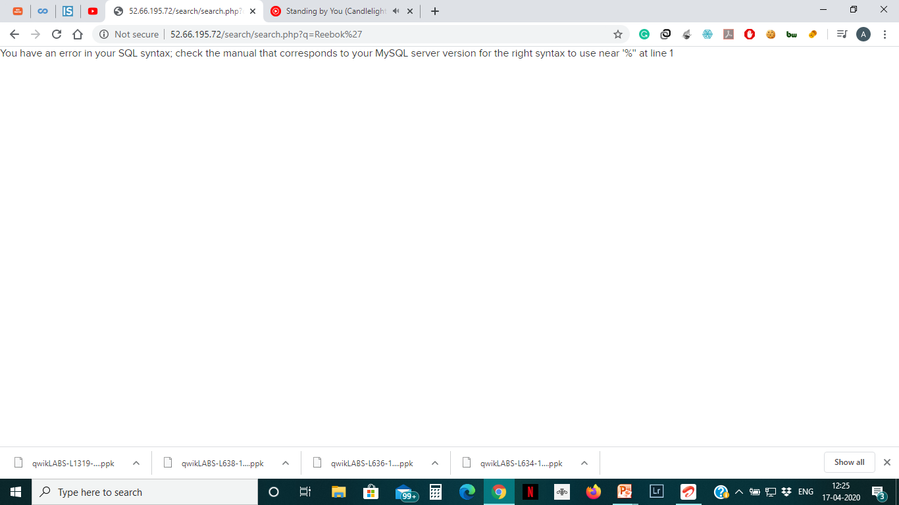
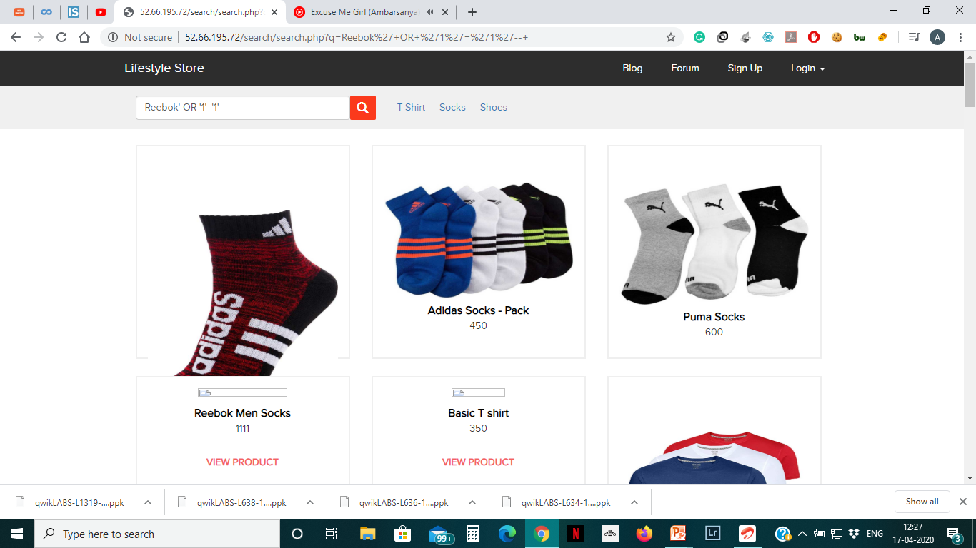
Observation
Opening the products page we see the following page which contains a search box as well. There is a GET parameter in the URL which we use for our SQLi exploitation. Inserting a ‘ at the end of the URL we get a SQL error showing that the URL is SQL Injectable.
After that we certain true conditions to confirm injection.

Slide 9
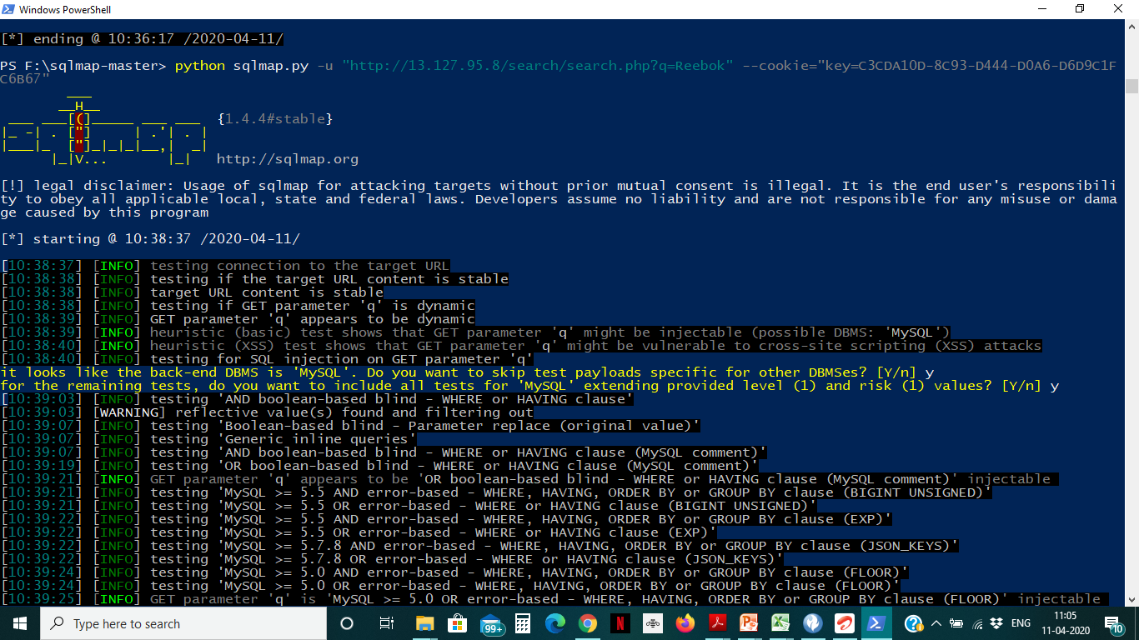
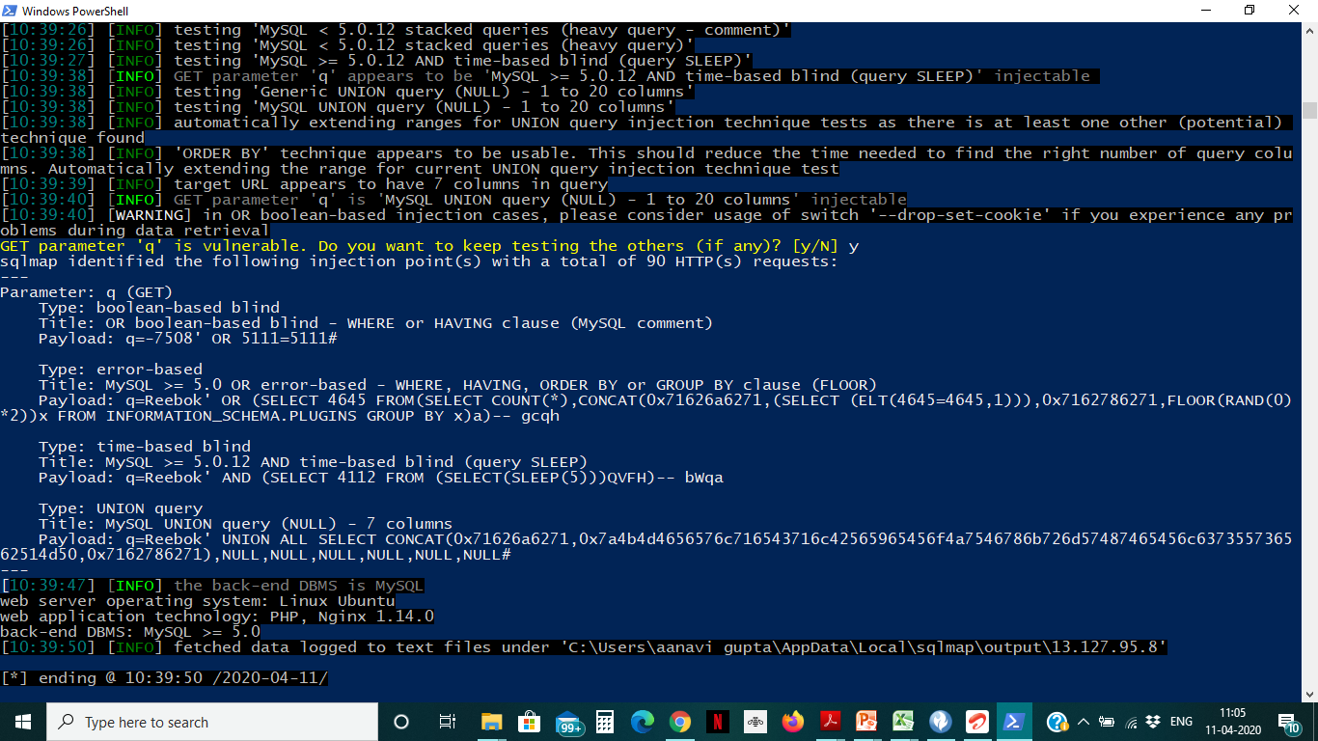
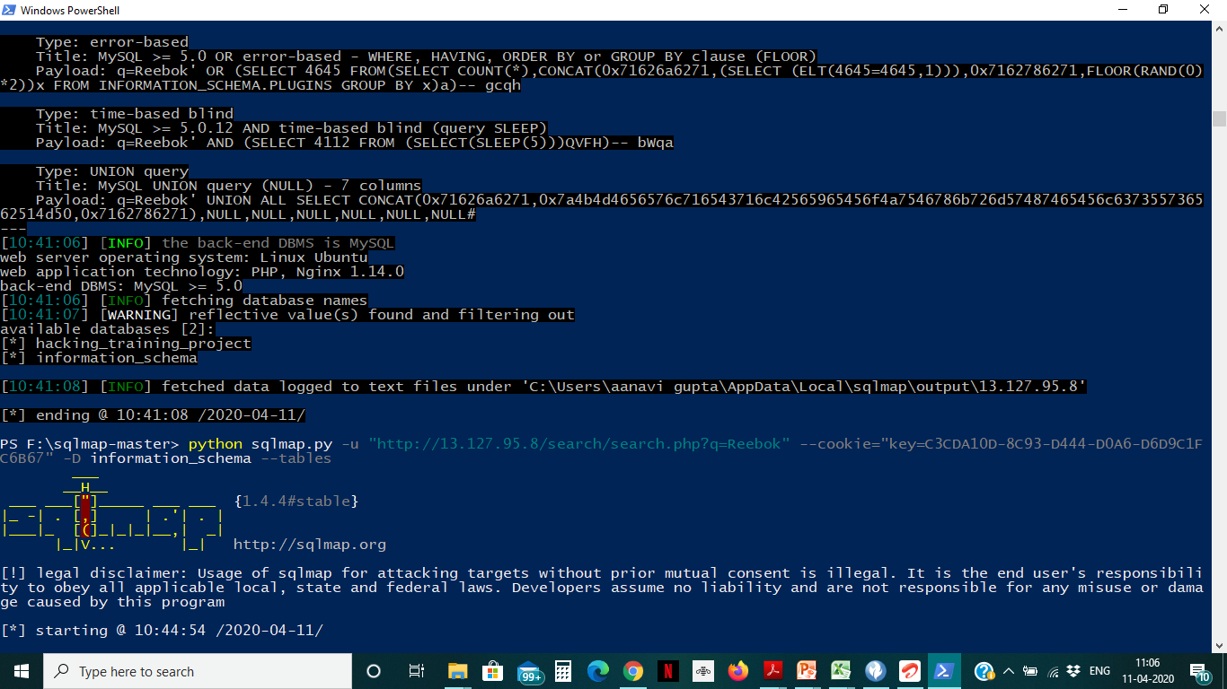
We used SQLMap for further injections on the q parameter and got the result as shown:

Slide 10
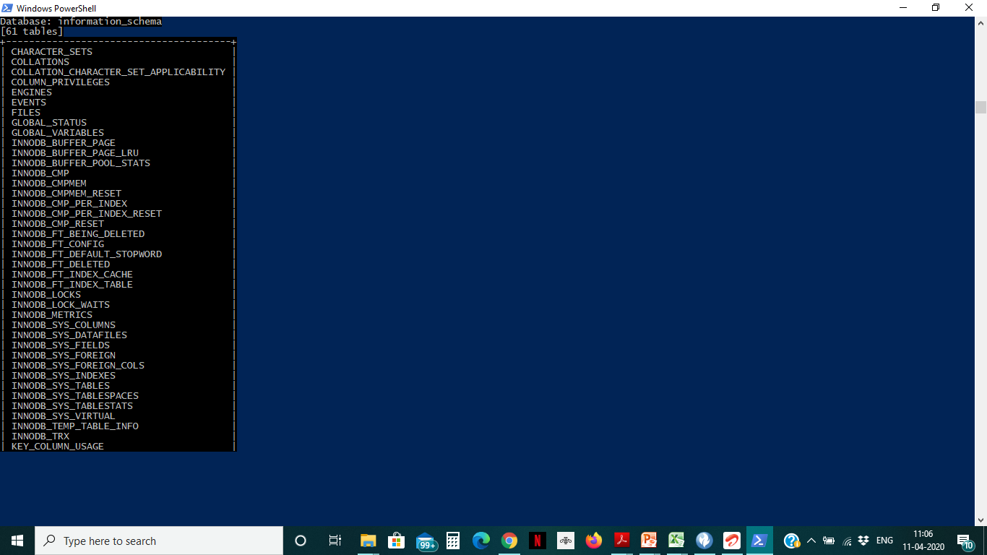
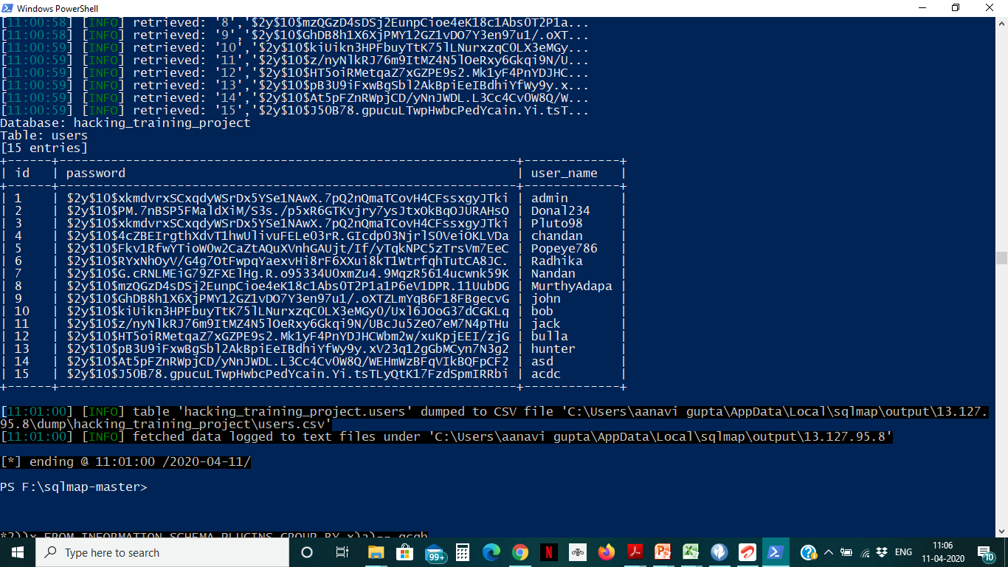
Proof of Concept (PoC)

Slide 11
Proof of Concept (PoC)
No. of Databases : 2
-information_schema
-hacking_training_project
No of tables in information_schema: 61
Few of them are:
FILES
EVENTS
COLUMNS
ENGINES
GLOBAL_STATUS
GLOBAL_VARIABLES
COLUMN_PRIVILEGES
No of Tables in hacking_training_project : 10
Few of them are:
brands
cart_items

Slide 12
Business Impact
Using this vulnerability, attacker can execute arbitrary SQL commands on Internshala server and gain complete access to internal databases along with all customer data inside it.
Alongside is the screenshot of users table which shows user credentials being leaked ,although with hashing, dictionary-based and logic-based brute forcing passwords can be cracked.

Slide 13
Recommendation
Take the following precautions to avoid exploitation of SQL injections:
Whitelist User Input: Whitelist all user input for expected data only. For example if you are expecting a flower name, limit it to alphabets only upto 20 characters in length. If you are expecting some ID, restrict it to numbers only
Prepared Statements: Use SQL prepared statements available in all web development languages and frameworks to avoid attacker being able to modify SQL query
Character encoding: If you are taking input that requires you to accept special characters, encode it. Example. Convert all ‘ to \’ , “ to \”, \ to \\. It is also suggested to follow a standard encoding for all special characters such has HTML encoding, URL encoding etc
Do not store passwords in plain text. Convert them to hashes using SHA1 SHA256 Blowfish etc
Do not run Database Service as admin/root user
Disable/remove default accounts, passwords and databases
Assign each Database user only the required permissions and not all permissions

Slide 14
References
https://www.owasp.org/index.php/SQL_Injection
https://en.wikipedia.org/wiki/SQL_injection

Slide 15
2. Arbitrary File Upload Vulnerability
Arbitrary File Upload (Critical) | Below mentioned URL is vulnerable to Arbitrary File Upload Affected URL : http://13.235.243.213/wondercms/ File Uploaded: 1.Sample php file 2.B374kmini.php(php shell)

Slide 16
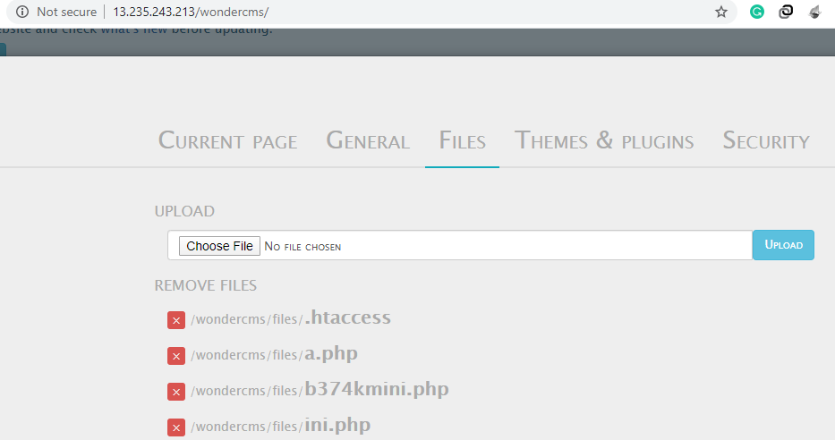
Observation
When we click on blog option, and login to the admin panel we see file upload option in settings, where we can upload any kind of file.

Slide 17
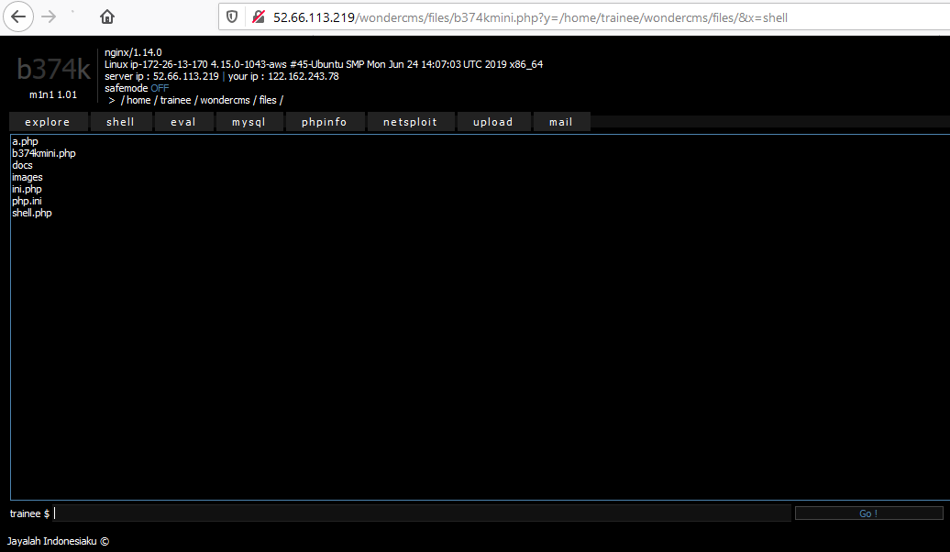
Proof of Concept
On uploading the shell we get complete control of the website and make changes as well by running commands on the shell.

Slide 18
Business Impact(High):
Using this vulnerability, the attacker can get complete control of the system, database and can also forward attacks in the back-end systems along with client-side attacks or simple defacement.
The impact of this vulnerability is high, as code can be executed in the server context or on the client side. A malicious file such as a Unix shell script, a windows virus, an Excel file with a dangerous formula, or a reverse shell can be uploaded on the server in order to execute code by an administrator or webmaster later -- on the victim's machine.
An attacker might be able to put a phishing page into the website or deface the website and much more.

Slide 19
Recommendations
Blacklisting File Extensions like .php,.php5,.shtml,etc
Whitelist the file extensions like .jpg,.pdf,etc
Content type header validation
Using File type detector
Perform proper server-side validations on what kind of a file user is uploading
Use white lists filters instead of black list filters. Example: in case of a resume upload feature, instead of banning PHP and .exe files, only allow .pdf, .doc and .docx files
Rename the files using a code, so that the attacker cannot play around with file names
Use static file hosting servers like CDNs and File Clouds to store files instead of storing them on the application server itself

Slide 20
References
https://www.owasp.org/index.php/Unrestricted_File_Upload
https://www.opswat.com/blog/file-upload-protection-best-practices

Slide 21
3. Access to admin panel
Access to admin panel (Critical) | Below mentioned URL gives access to admin panel. Affected URL : http://13.235.243.213/wondercms/loginURL

Slide 22
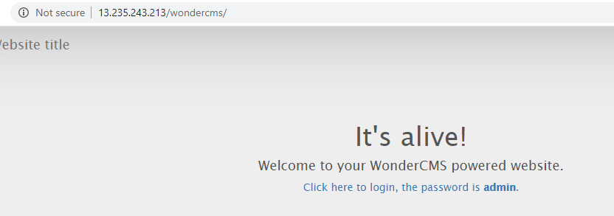
Observation
When we open 'http://13.235.243.213/wondercms/loginURL' URL ,we get the password on the page and login as admin. The password is written as such on the webpage.

Slide 23
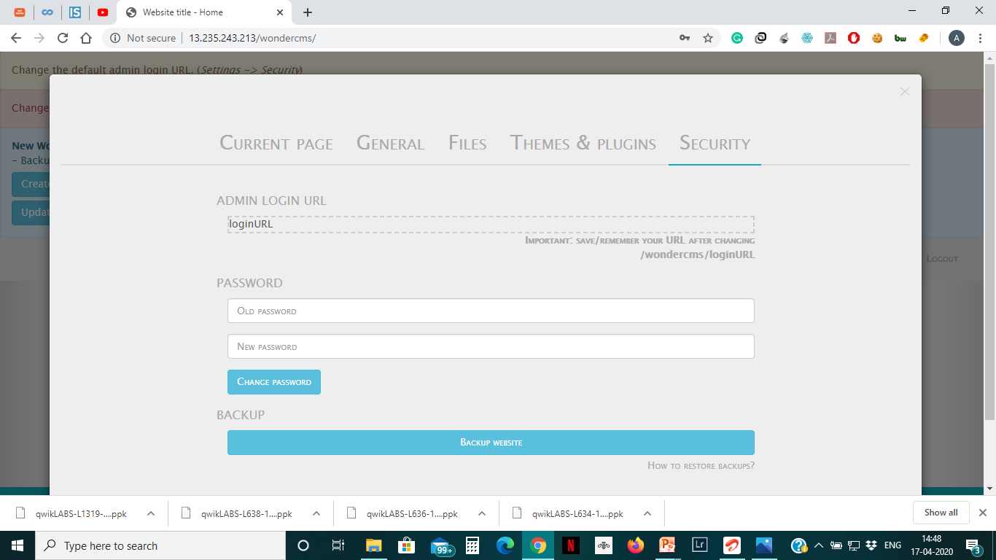
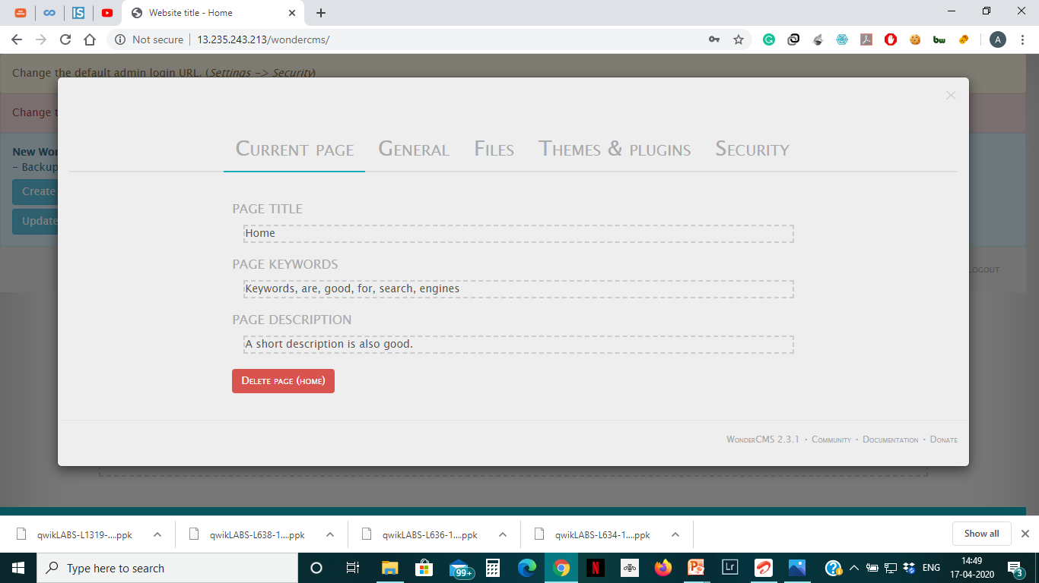
Proof Of Concept
We can change the password, thus the actual admin may not able to login. The pages can be added and deleted as well.

Slide 24
Business Impact(Extremely High):
Using this vulnerability, the attacker can get complete access to the blog of the website.
The attacker can change the password or even change the URL of the admin panel and restrict the admin to access it.
Even pages can be created and deleted along with editing.
Files can be added (without verification) and hence can be dangerous to the entire website, as the control of the entire website can be taken.

Slide 25
Recommendation
The default password should be changed and a strong password must be setup.
The admin URL must also be such that its not accessible to normal users.
Password changing option must be done with 2 to 3 step verification.
Password must be at least 8 characters long containing numbers,alphanumerics,etc.
All the default accounts should be removed.
Password should not be reused.

Slide 26
References
1)https://www.owasp.org/index.php/Testing_for_weak_password_change_or_reset_functionalities_(OTG-AUTHN-009)
2)https://www.owasp.org/index.php/Default_Passwords
3)https://www.us-cert.gov/ncas/alerts/TA13-175A

Slide 27
4.Account takeover via OTP Bypass
Account Takeover Using OTP Bypass (Critical) | The below mentioned login page allows login via OTP which can be brute forced. Affected URL : http://13.235.243.213/reset_password/admin.php Affected Parameters : OTP (POST parameters)

Slide 28
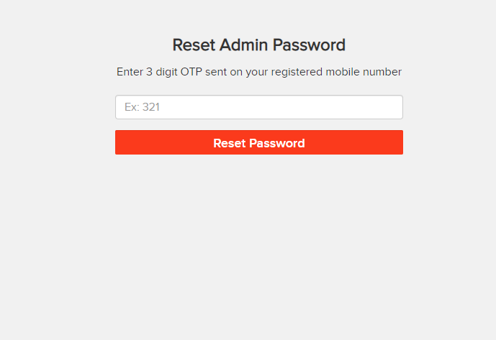
Observation
When we navigate to admin login and the forgot password page in order to reset the password we are directed to the following URL: 'http://13.235.243.213/reset_password/admin.php',and when we try to reset the password, we are asked for the three digit OTP as:

Slide 29
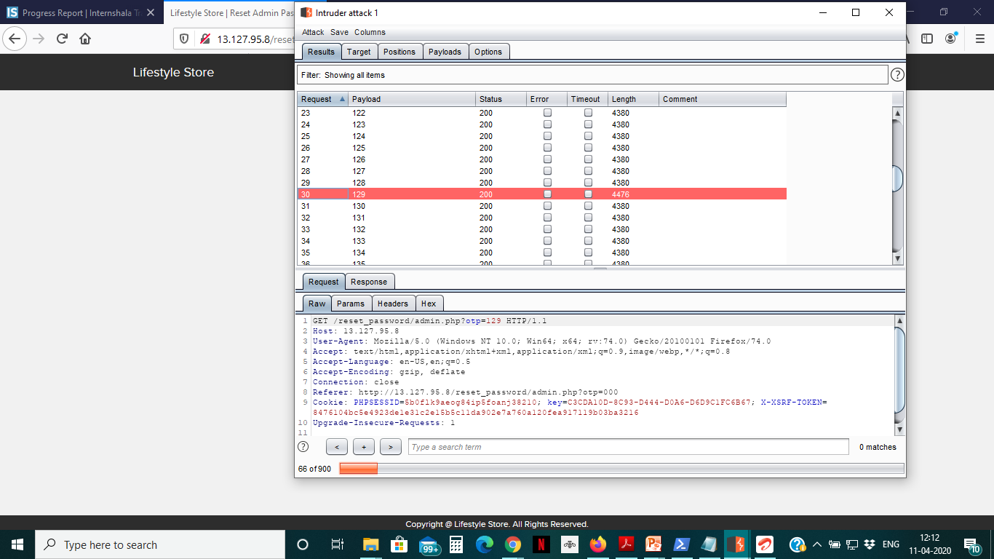
Observation
Following request will be generated containing OTP parameter. This has been intercepted in Burp Suite.

Slide 30
Observation
We shoot the request with all possible combinations of 3 Digit OTPs and upon a successful hit, we get a response containing “Enter New Admin Password”. We can use the same OTP then to login. This is done in the intruder mode of the Burp Suite software.

Slide 31
Business Impact: Extremely High
After logging in as the admin , the attacker gets almost all the control of the website business.
Right from changing the seller details with their corresponding product to adding false products.
They can make customers pay for false products and this may have a great business impact and hamper the privacy too.
Also ,changing the cost of products can cause severe financial loss to the owner .

Slide 32
Recommendations
1)The length of the OTP should be increased to at least 6 digits. This will make brute forcing very impractical and difficult.
2)There should be at least two-step verification before resetting the password.
3) Captcha can also be used to protect from brute forcing.
4)Number of attempts should be made limited.

Slide 33
References
1)https://www.cloudways.com/blog/what-is-brute-force-attack/
2)https://www.owasp.org/index.php/Blocking_Brute_Force_Attacks

Slide 34
5) Unauthorized access to customer details
Unauthorised access to customer details (Critical) | Below mentioned URL is vulnerable to IDOR(Displaying customer details) Affected URL : http://13.233.233.143/profile/14/edit/ http://13.233.233.143/orders/orders.php?customer=14 Affected Parameters : user_id(POST parameter) customer(GET parameter) Payload: Changing user_id from 16 to 14 in the URL itself

Slide 35
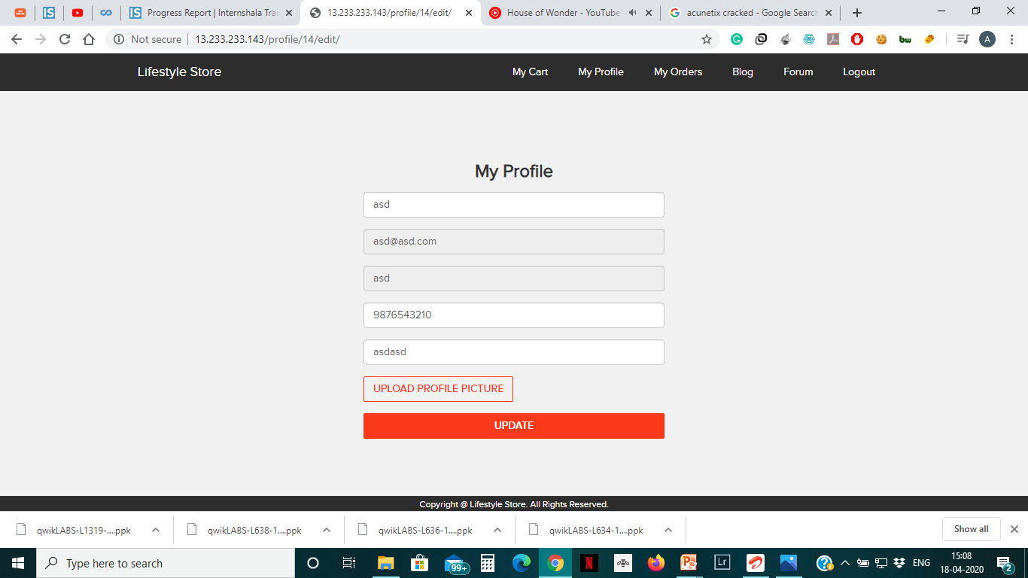
Observation
In the URL a get parameter was noticed. The user id parameter was changed to 14 from 16 and the profile details of another user were visible.

Slide 36
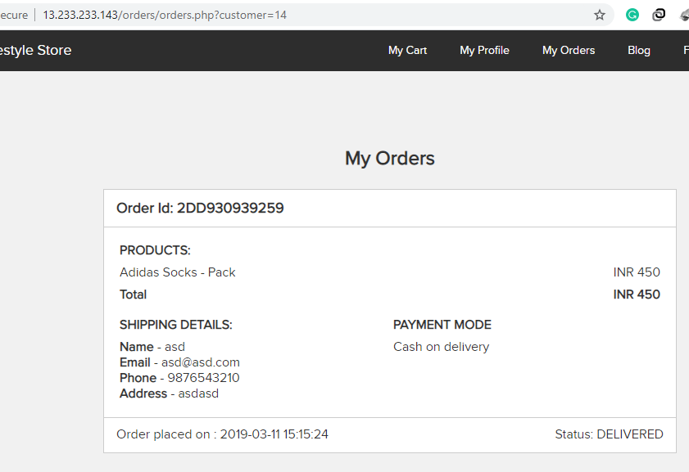
Proof Of Concept
A similar case is seen in the my orders tab, by changing the get parameter we can easily retrieve order details of another customer. The get parameter in this case is customer.

Slide 37
Business Impact(High)
Taking the advantage of this vulnerability, if the attacker can get sensitive data of multiple users, it becomes easier for the attacker to know their login details and make unwanted changes as well.
The revealed data includes (name ,username, email address, phone number ,etc.) are sufficient for performing a full fledged social engineering attack on the user.

Slide 38
Recommendation
Implement proper authentication and authorisation checks to make sure that the user has permission to the data he/she is requesting
Use proper rate limiting checks on the number of request comes from a single user in a small amount of time
Make sure each user can only see his/her data only.

Slide 39
References
https://www.owasp.org/index.php/Insecure_Configuration_Management
https://www.owasp.org/index.php/Top_10_2013-A4-Insecure_Direct_Object_References

Slide 40
6) Cross Site Scripting(XSS)
Cross Site Scripting (Severe) | Below mentioned parameters are vulnerable to XSS Affected URL : http://52.66.113.219/products/details.php?p_id=2 (all product ids have this vulnerability) Affected Parameters : comment(POST parameters) Payload: <script>alert(1);</script>

Slide 41
Cross Site Scripting (Severe) | Similar issue is found on below modules too Affected URL : http://52.66.198.61/profile/16/edit/ Affected Parameters : address(POST ) Payload: <script>alert(1);</script>
 | Affected URL : http://52.66.198.61/wondercms/ Affected Parameters : title(POST),and all the below it. Payload: <script>alert(1);</script>

Slide 42
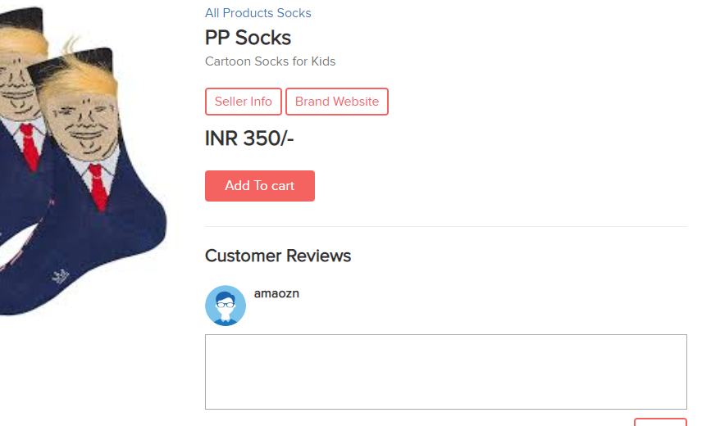
Observation
When we navigate to the product’s page, there is a comments section at the bottom. On entering the payload here and refreshing the page, the script is executed and XSS is confirmed.

Slide 43
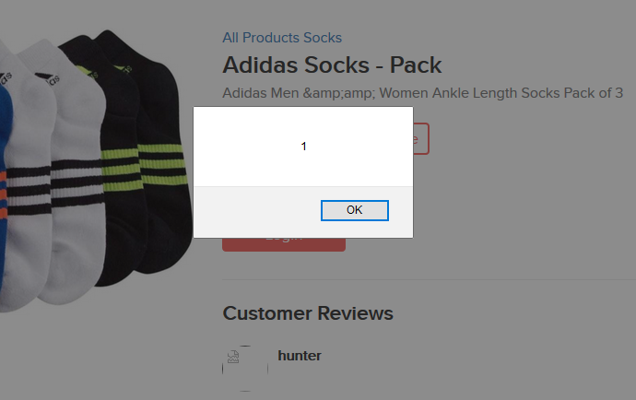
Proof Of Concept
When we enter <script>alert(1);</script> and post it, we get the new page as:

Slide 44
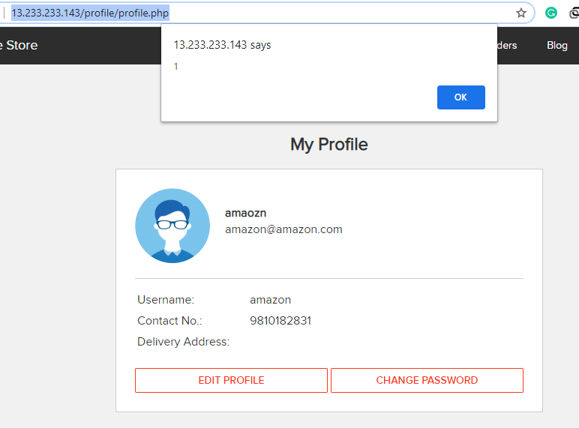
Proof Of Concept
When we enter the same payload in the address portion and update it in the URL - 'http://52.66.198.61/profile/16/edit/' ,we get:

Slide 45
Business Impact – High
As attacker can inject arbitrary HTML CSS and JS via the URL, attacker can put any content on the page like phishing pages, install malware on victim’s device and even host explicit content that could compromise the reputation of the organization
All attacker needs to do is send the link with the payload to the victim and victim would see hacker controlled content on the website. As the user trusts the website, he/she will trust the content.

Slide 46
Recommendation
Take the following precautions:
Sanitise all user input and block characters you do not want
Convert special HTML characters like ‘ “ < > into HTML entities &quot; %22 &lt; &gt; before printing them on the website

Slide 47
References
https://www.owasp.org/index.php/Cross-site_Scripting_(XSS)
https://en.wikipedia.org/wiki/Cross-site_scripting
https://www.w3schools.com/html/html_entities.asp

Slide 48
7)Cross Site Request Forgery(CSRF)
Cross Site Request Forgery(Severe) | CSRF is found in the modules below:- Affected URL : http://52.66.198.61/profile/change_password.php Affected Parameters : Update(POST)
 | Affected URL : http://52.66.198.61/cart/cart.php Affected Parameters : Confirm order option(POST)

Slide 49
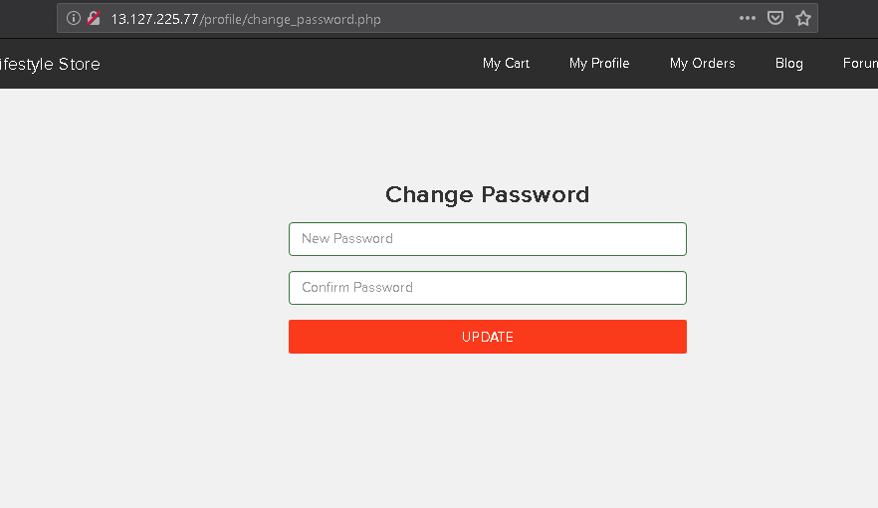
Observation
We navigate to 'http://52.66.198.61/profile/change_password.php' after logging in to our account.

Slide 50
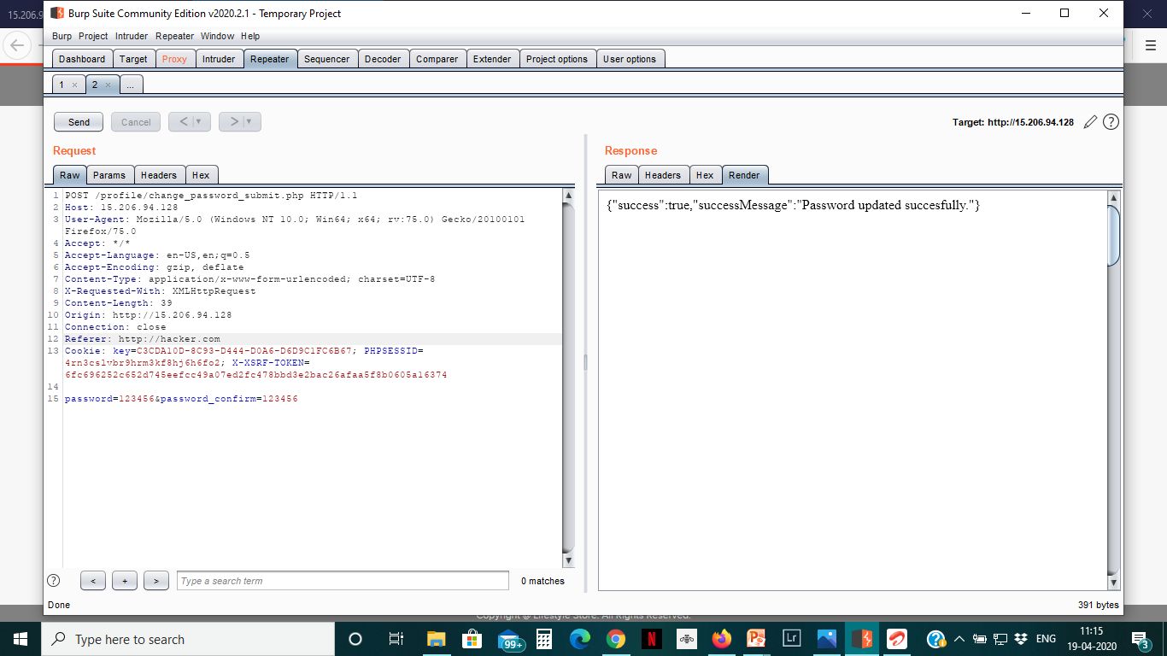
Observation:
To check whether the update parameter checks the referrer or not ,we intercept it on Burp suite, and send it to repeater for verification. On changing the referrer to something malicious, it does not raise an error and the request is passed on as it is.

Slide 51
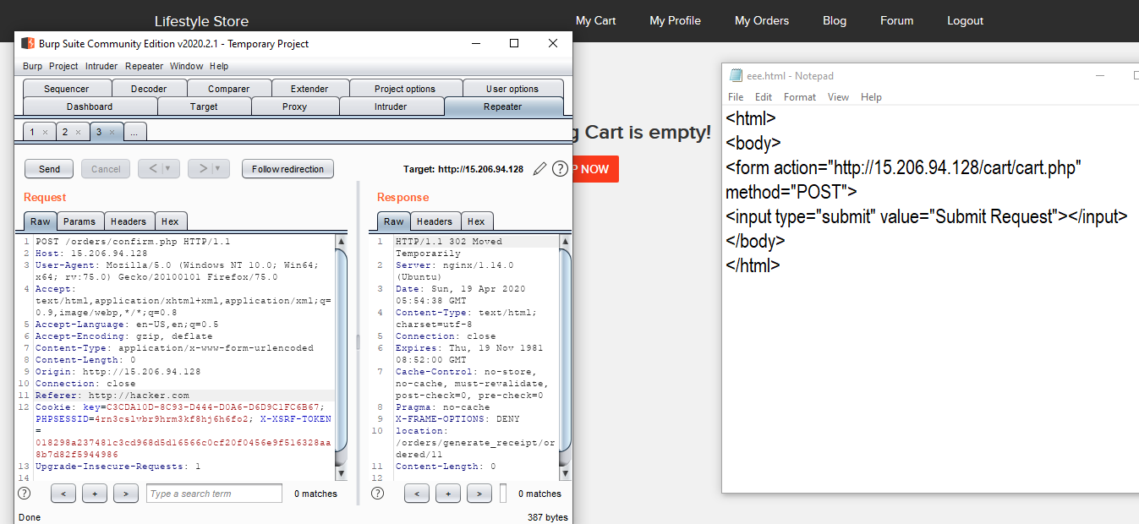
Proof Of Concept
Similar vulnerability is seen in the my cart URL, when we run an html page that contains a submit button pointing to the my cart URL with it, it does not raise an error and empties the cart.

Slide 52
Business Impact (High)
If the attacker is able to exploit this vulnerability, he may be able to order many items which the user would cancel later hence incorrect deliveries maybe made.
Moreover, the attacker maybe able to change the user's password without his consent, which in itself is highly insecure.

Slide 53
Recommendations
Ask the user his password (temporary like OTP or permanent like login password) at every critical action, like deleting account, making a transaction, changing the password etc.
Implement the concept of CSRF tokens which attach a unique hidden password to every user in every
Read the documentation related to the programming language and framework being used by your website
Check the referrer before carrying out actions. This means that any action on x.com should check that the HTTP referrer is https://x.com/* and nothing else like https://x.com.hacker.com/*

Slide 54
References
1)https://en.wikipedia.org/wiki/Cross-site_request_forgery#Example_and_characteristics
2)https://www.owasp.org/index.php/Cross-Site_Request_Forgery_(CSRF)https://www.owasp.org/index.php/Cross-Site_Request_Forgery_(CSRF)

Slide 55
8)Crypto Configuration Flaw
Crypto Configuration Flaw(Severe) | Cryto Configuration Flaws are found in the modules below:- Affected URL : http://52.66.198.61/ (All the webpages ,blogs,forum)

Slide 56
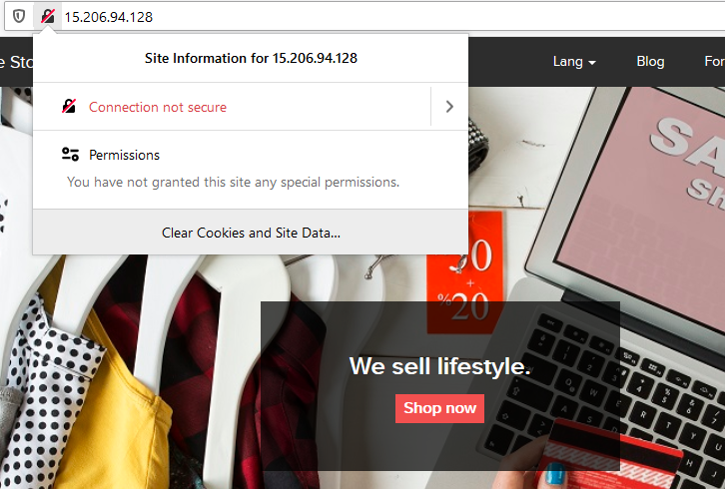
Observation
As seen in the URL’s ,all the webpages use 'http' and not 'https' which is far less secure and not encrypted.

Slide 57
Recommendation:
Business Impact(High):
When the web application uses http protocol it becomes vulnerable to many attacks. This can harm the brand of the company and attackers can easily find point s to inject queries/shells and other malicious content.
Use https and not http as the protocol.
References:
1)https://www.owasp.org/index.php/Category:Cryptographic_Vulnerability
2)https://www.w3.org/Protocols/rfc2616/rfc2616-sec15.html

Slide 58
9)Common Passwords:
Crypto Configuration Flaw(Severe) | Cryto Configuration Flaws are found in the modules below:- Affected URL : http://52.66.198.61/login/seller.php http://52.66.198.61/wondercms/

Slide 59
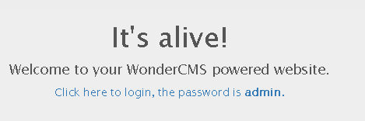
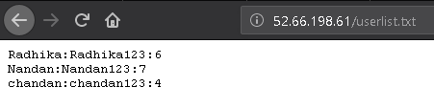
Observation:
The passwords of sellers and admin are very predictable and also have been mentioned without proper access control.

Slide 60
Business Impact(High):
Easy, default and common passwords make it easy for attackers to gain access to their accounts illegal use of them and can harm the website to any extent after getting logged into privileged accounts.
Recommendation:
1)There should be password strength check at every creation of an account.
2)There must be a minimum of 8 characters long password with a mixture of numbers,alphanumerics,special characters,etc.
3)There should be no repetition of password, neither on change nor reset.
4)The password should not be stored on the web, rather should be hashed and stored.

Slide 61
References:
1)https://www.acunetix.com/blog/articles/weak-password-vulnerability-common-think/
2)https://www.owasp.org/index.php/Testing_for_Weak_password_policy_(OTG-AUTHN-007)

Slide 62
10)Directory Listing
Directory Listing (Moderate) | Below mentioned parameters are vulnerable to Directory Listing Affected URL : http://35.154.118.58/static/images/

Slide 63
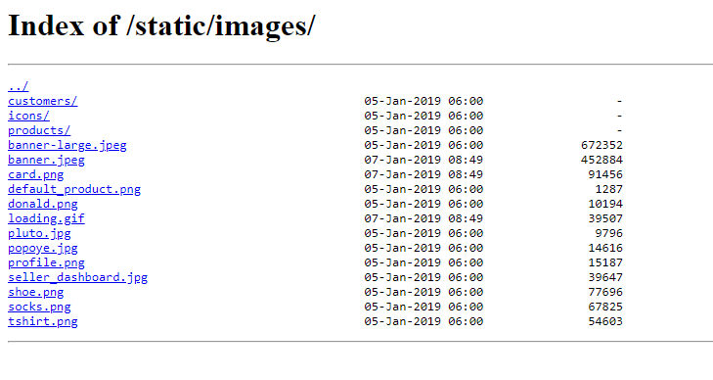
Observation:
1)Navigate to http://35.154.118.58/static/images/
2)Complete listing of directory is shown containing names of files and folders of the website

Slide 64
Business Impact :Moderate
Although this vulnerability does not have a direct impact to users or the server, though it can aid the attacker with information about the server and the users
Also, attacker can simply download the backups / images and view them.

Slide 65
Recommendation:
Disable Directory Listing
Put an index.html in all folders with default message
References:
https://cwe.mitre.org/data/definitions/548.html
https://www.netsparker.com/blog/web-security/disable-directory-listing-web-servers/

Slide 66
11) Unrequired details for seller
Unrequired Details for seller (Moderate) | Below mentioned URL gives the unrequired details about the seller: Affected URL : http://35.154.118.58/products/details.php?p_id=2(or any other p_id)

Slide 67
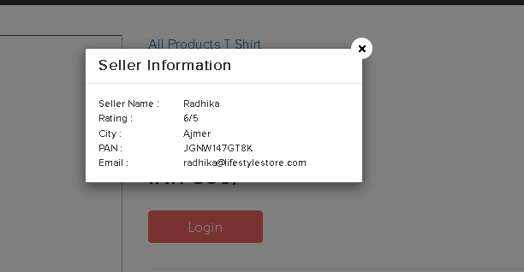
Observation
When we click on the “Seller Info” option, we get the details of the seller ,even those which are not required like the pan card number.

Slide 68
Business Impact(Moderate)
There is no direct business impact in this case ,but this amount of information can definitely lead to social engineering attacks on the seller and can indirectly harm the business.

Slide 69
Recommendation
Only name and email is sufficient as far as the query or help is concerned.

Slide 70
12) Outdated Elements:
Outdated Elements (Moderate) | Affected Elements : PHP WonderCMS

Slide 71
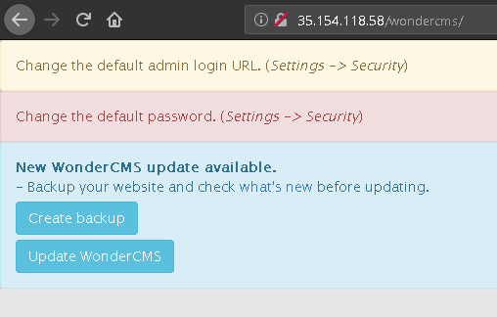
Observations
The PHP version installed is not the latest one and has multiple vulnerabilities that can be exploited. Also, wondercms is also outdated and highly vulnerable.

Slide 72
Business Impact(High)
Exploits of every vulnerability detected is regularly made public and hence outdated software can very easily be taken advantage of. If the attacker comes to know about this vulnerability, he may directly use the exploit to take down the entire system, which is a big risk.

Slide 73
Recommendation
1) Upgrade to the latest version of the affected Software/theme/plugin/OS which means latest version number
2) If upgrade is not possible for the time being, isolate the server from any other critical data and servers
References
1)https://www.cvedetails.com/vulnerability-list/vendor_id-74/product_id-128/version_id-298515/PHP-PHP-5.6.39.html
2)https://www.owasp.org/index.php/Top_10-2017_A9-Using_Components_with_Known_Vulnerabilities

Slide 74
13) Improper Server Side Filter
Improper Server Side Filter (Low) | Below mentioned URLs have improper server side filter Affected URL : http://13.233.108.21/profile/16/edit/ Affected parameter: Contact Number

Slide 75
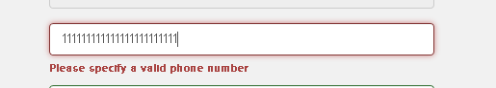
Observation
After logging in as customer,when we try to edit our phone number to some invalid one ,the error is as shown.

Slide 76
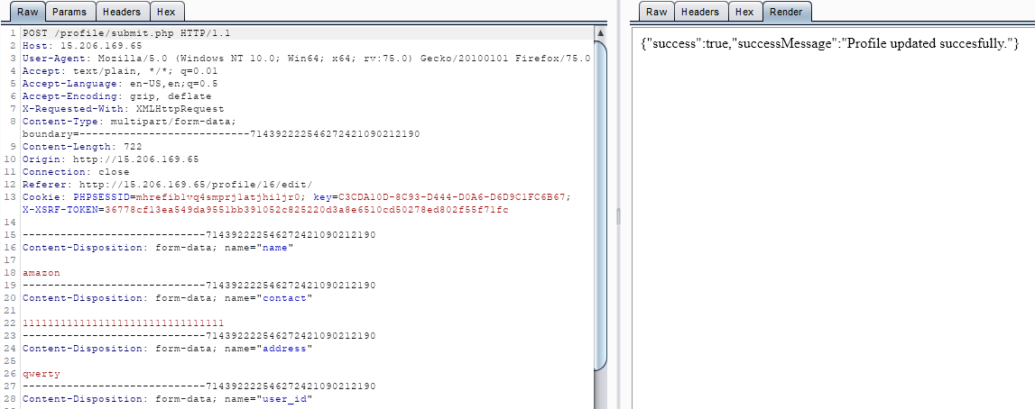
Proof Of Concept
But when we give a valid phone number on the client side, but intercept it through burp suite and again give invalid number, it gets accepted.

Slide 77
Business Impact(Low)
The data provided by the user ,if incorrect, is not a very big issue but still must be checked for proper validation.
Recommendation
1) Implement all critical checks on server side code only
2)Client-side checks must be treated as decorative only
3)All business logic must be implemented and checked on the server code. This includes user input, the flow of applications and even the URL/Modules a user is supposed to access or not.

Slide 78
References
1)http://projects.webappsec.org/w/page/13246933/Improper%20Input%20Handling
2)https://www.owasp.org/index.php/Unvalidated_Input

Slide 79
14)Default Error Display
Default Error Display (Low) | Below mentioned URLs have default error displaying on fuzzing: Affected URL : http://35.154.118.58/?includelang=lang/en.php Payload en'.php
 | Affected URL: http://35.154.118.58/search/search.php Parameter: q(GET) Payload q='

Slide 80
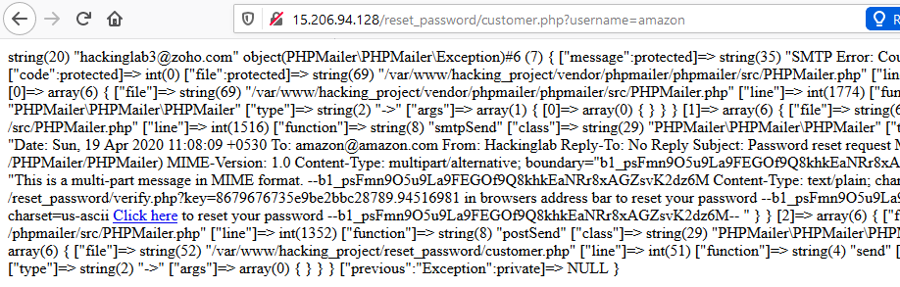
Observation
Many default error messages are providing too much information which may help the attacker understand the software and hence attack the website as well.

Slide 81
Proof Of Concept
When we give ' in the search option of the home page,we get the error as:

Slide 82
Business Impact(Moderate)
Although this vulnerability does not have a direct impact to users or the server, though it can help the attacker in mapping the server architecture and plan further attacks on the server.
Recommendation
Do not display the default error messages because it not only tells about the server but also sometimes about the location.So,whenever there is an error ,send it to the same page or throw some manually written error.

Slide 83
References
https://www.owasp.org/index.php/Improper_Error_Handling

Slide 84
15) Default Debug Pages
Default Debug Pages (Low) | Below mentioned URLs have default debug pages. Affected URL : http://35.154.118.58/ Default pages available: robots.txt sever-status phpinfo.php userlist.txt

Slide 85
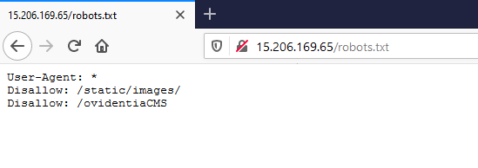
Proof Of Concept
When we entered robots.txt at the end of the index page URL,we got:

Slide 86
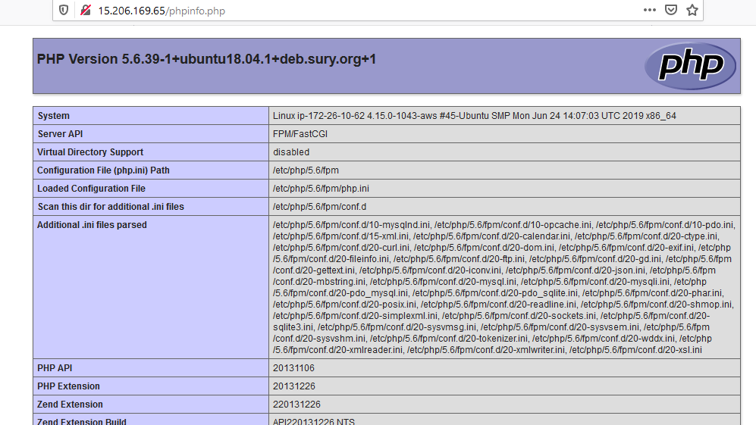
Proof Of Concept
When we entered phpinfo.php at the end ,we got:

Slide 87
Business Impact – Moderate
Although this vulnerability does not have a direct impact to users or the server, though it can help the attacker in mapping the server architecture and plan further attacks on the server
Recommendation
Disable all default pages and folders including server-status and server-info
References:
https://vuldb.com/?id.88482
https://httpd.apache.org/docs/current/mod/mod_status.html
https://www.beyondsecurity.com/scan_pentest_network_vulnerabilities_apache_http_server_httponly_cookie_information_disclosure

Slide 88
16) Open Redirection
Open Redirection(Severe) | Open Redirection vulnerability are found in the module below:- Affected URL : http://52.66.198.61/products/details.php?p_id=5 Affected parameter : URL (Brand Website)

Slide 89
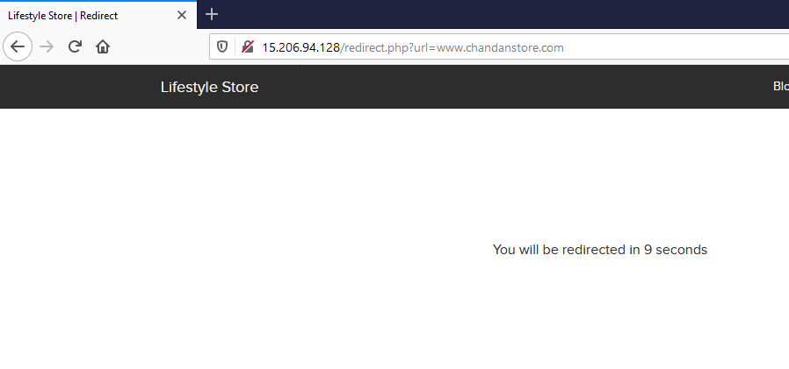
Observation
When we view any product ,and click on “Brand Website” tab as shown, then we get redirected to it openly as GET parameter.

Slide 90

Proof Of Concept
We can change the URL after redirect to be redirected anywhere and an attacker can use this vulnerability to direct the user to a malicious website.

Slide 91
Business Impact(High)
If the attacker changes the URL to some malicious website looking similar to the given website, he can take the credentials and even credit card details on checkout from the user trust.

Slide 92
Recommendation
If possible, applications should avoid incorporating user-controllable data into redirection targets. In many cases, this behavior can be avoided in two ways:
1) Remove the redirection function from the application, and replace links to it with direct links to the relevant target URLs.
2) Maintain a server-side list of all URLs that are permitted for redirection. Instead of passing the target URL as a parameter to the redirector, pass an index into this list.
If it is considered unavoidable for the redirection function to receive user-controllable input and incorporate this into the redirection target, one of the following measures should be used to minimize the risk of redirection attacks:
1)The application should use relative URLs in all of its redirects, and the redirection function should strictly validate that the URL received is a relative URL.
2) The application should use URLs relative to the web root for all of its redirects, and the redirection function should validate that the URL received starts with a slash character. It should then prepend http://yourdomainname.com to the URL before issuing the redirect.
3)The application should use absolute URLs for all of its redirects, and the redirection function should verify that the user-supplied URL begins with http://yourdomainname.com/ before issuing the redirect.

Slide 93
References
https://portswigger.net/kb/issues/00500100_open-redirection-reflected
https://www.owasp.org/index.php/Testing_for_Client_Side_URL_Redirect_(OTG-CLIENT-004)

Slide 94
THANK YOU For patch assistance/clarifications contact +91 7742892360

